Slide 1




GEMOC Studio Tutorial
ICSA Conference, April, 2017
Barais, Combemale, Vojtisek, Wortmann
Inria & Univ. Rennes 1
http://diverse.irisa.fr/

Slide 2




People
Olivier Barais Inria & Univ. Rennes 1 | Benoit Combemale Inria & Univ. Rennes 1 | Didier Vojtisek Inria | Andreas Wortmann Inria & Univ. Rennes 1 RWTH Aachen

Slide 3
"Software languages are software too"
J-M. Favre, D. Gasevic, R. Lämmel, and E. Pek. "Empirical language analysis in software linguistics," In Software Language Engineering, volume 6563 of LNCS, pages 316–326. Springer, 2011.

Slide 4


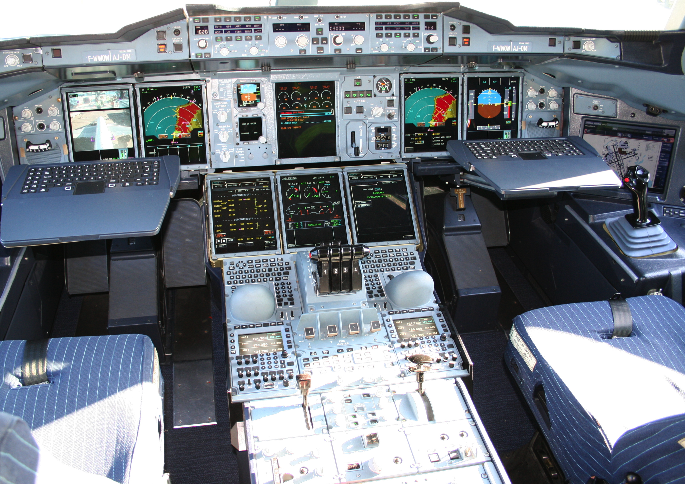









Mechanical
Structure
Airlines
Human-Machine Interaction
Avionics
Multiple
Concerns
Aerodynamics
Environmental
Impact
Propulsion
System
Safety
Regulations
Communications
Authorities
Navigation
Notes:
This piece of complex software integrates different perspectives from these stakeholders
Physics, communications, Pilots -> HCI

Slide 5
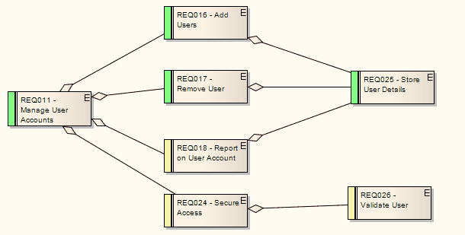
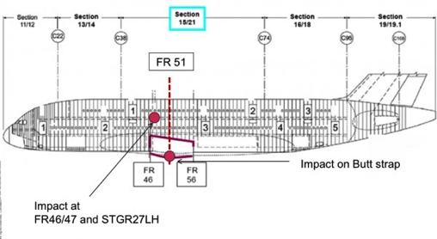
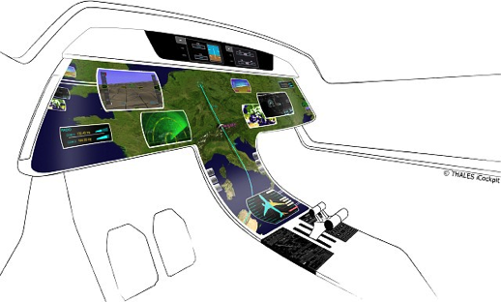
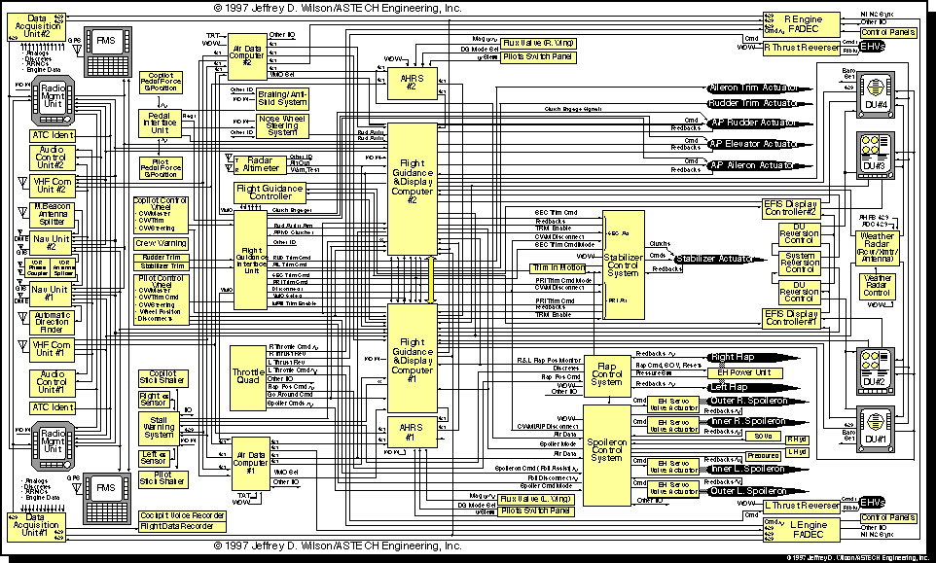
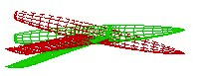
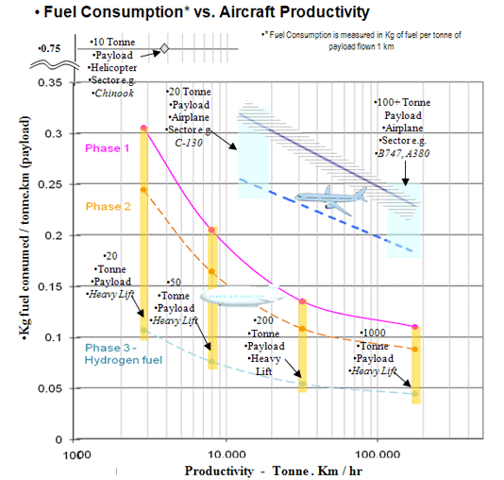
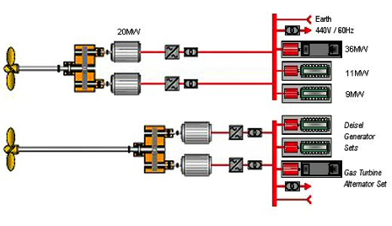
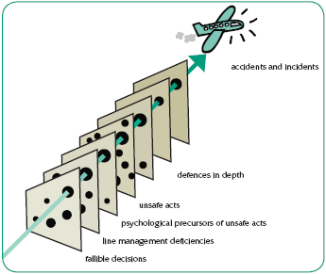
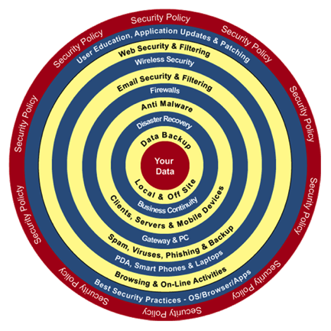
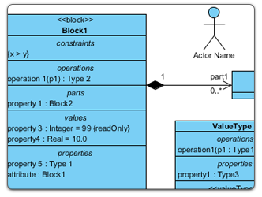
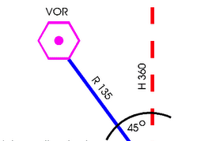
Mechanical
Structure
Airlines
Human-Machine Interaction
Avionics
Heterogeneous Modeling
Aerodynamics
Environmental
Impact
Propulsion
System
Safety
Regulations
Communications
Authorities
Navigation
Notes:
Parler ici du positionnement avec la co-simulation

Slide 6

GEMOC initiative
An open and international initiative to
foster globalization of DSMLs in open world
impossible a priori unification
require a posteriori globalization
coordinate (between members) and disseminate (for the members)
Organizes
workshop series
Dagstuhl and Bellairs seminars
http://gemoc.org @gemocinitiative

Slide 7



GEMOC studio
http://gemoc.org/studio
Language
Workbench
Modeling
Workbench
Design and compose your executable DSMLs
Edit and debug
your heterogeneous models

Slide 8
This tutorial
See how EMF+GEMOC technologies help to (semi-automatically) build the tooling for a DSL IDE
Extend a DSL: structure and behavior
Lectures and hands-on sessions
Combine both DSLs
Materials are available from https://github.com/gemoc/ICSA2017Tutorial

Slide 9


Course content
Part 1. General introduction
Modeling and Languages
Part 2. Language Engineering
Teaser: FSM Example
Metamodeling: Ecore OCL
Syntax: Sirius
Dynamics: K3/Melange
Part 3. Wrap-up and Discussion
Coordination

Slide 10
You will learn how to
Build or customize your own abstractions, or even software languages and development environments, to build complex, domain-specific, software-intensive systems
Apply language formalisms, paradigms and principles
Extend a graphical, executable DSL using state of the art techniques
Manage the industrial complexity of developments and associated toolchains

Slide 11
A few notes on the tutorial
Interweave a total of 90 min introduction to SLE and 90 min hands-on time
Creating a sufficiently interesting, yet full-blown, modeling language including syntax, semantics, and editors in 90 minutes is challenging to impossible
To introduce the quintessential aspects of language engineering to you we will ask you to clear your workspace and download different stages of the languages under development. Please look out for the following symbol: on the tutorial website https://github.com/gemoc/ICSA2017Tutorial

Slide 12
"Software languages are software too"
J-M. Favre, D. Gasevic, R. Lämmel, and E. Pek. "Empirical language analysis in software linguistics," In Software Language Engineering, volume 6563 of LNCS, pages 316–326. Springer, 2011.

Slide 13
LANGUAGE ENGINEERING
PART 2

Slide 14
What is a language?
“A system of signs, symbols, gestures, or rules used in communication”
The special vocabulary and usages of a scientific, professional, or other group”
“A system of symbols and rules used for communication with or between computers”
“The words, their pronunciation, and the methods of combining them used and understood by a community”

Slide 15
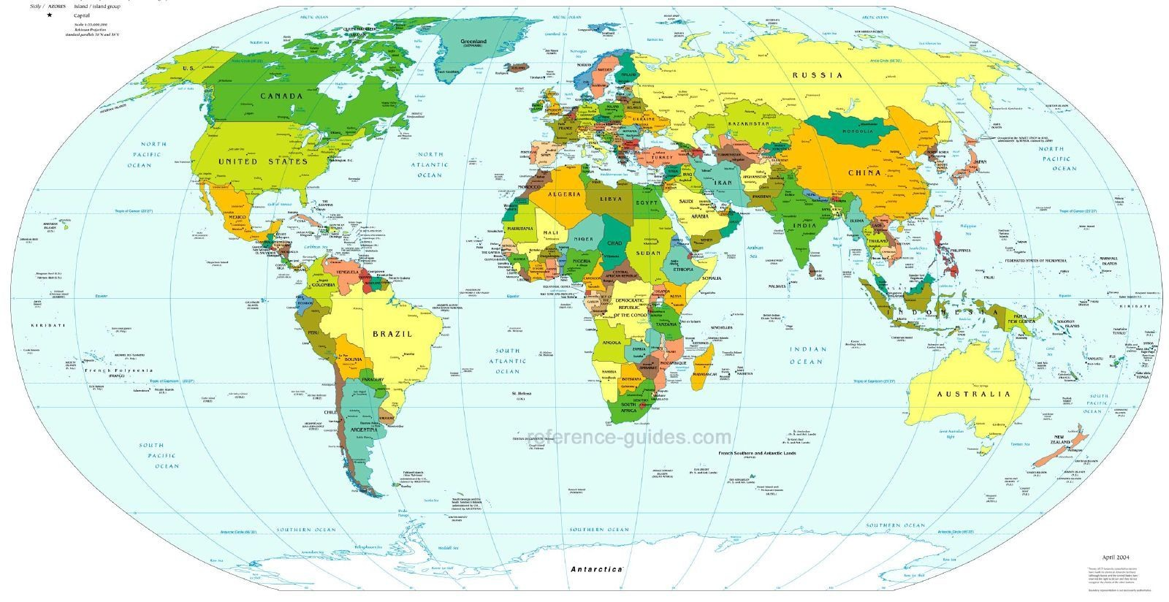
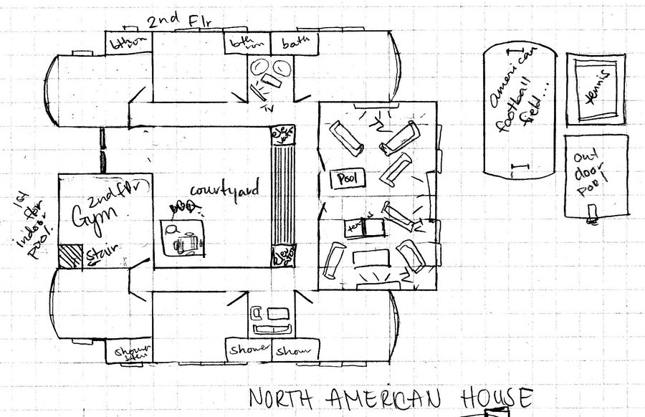
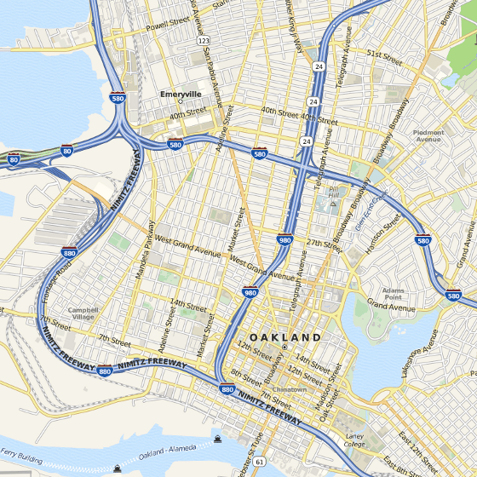
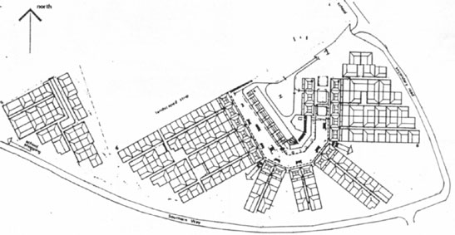
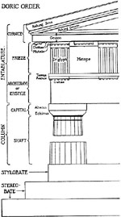
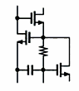
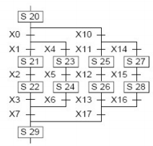
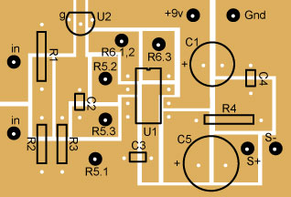
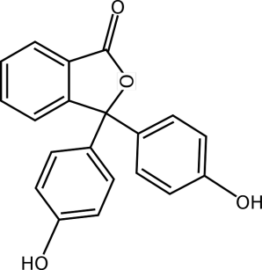
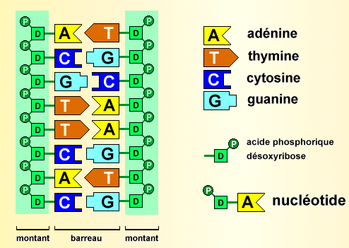
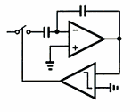
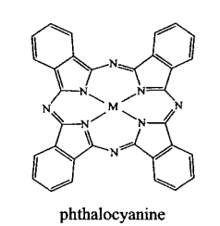
Languages in various domains
Cartography
Architecture
Electronics
Biology

Slide 16
Languages in software engineering
“Languages are the primary way in which system developers communicate, design and implement software systems”

Slide 17
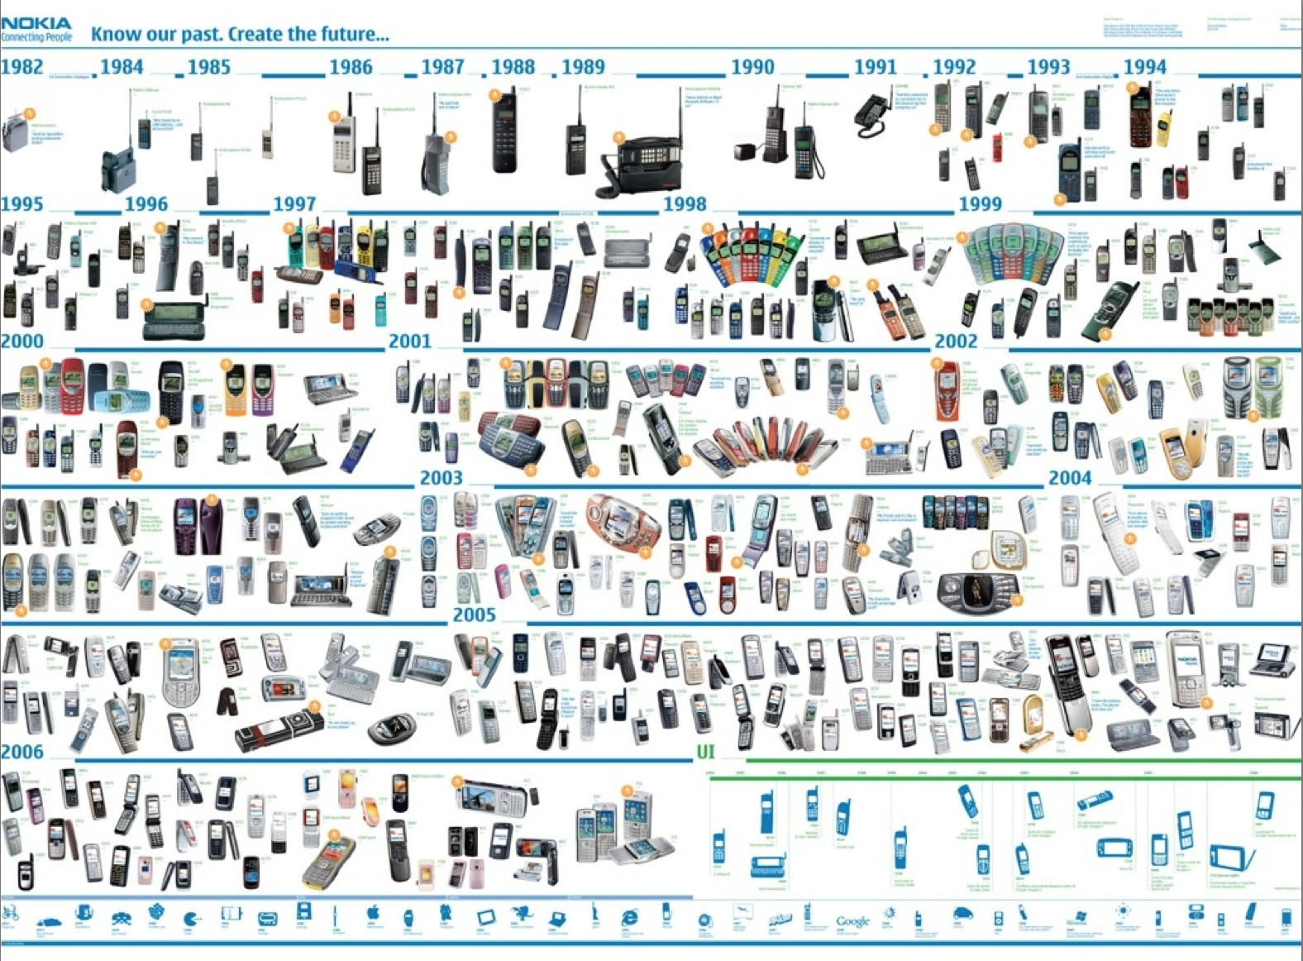





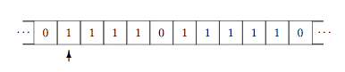
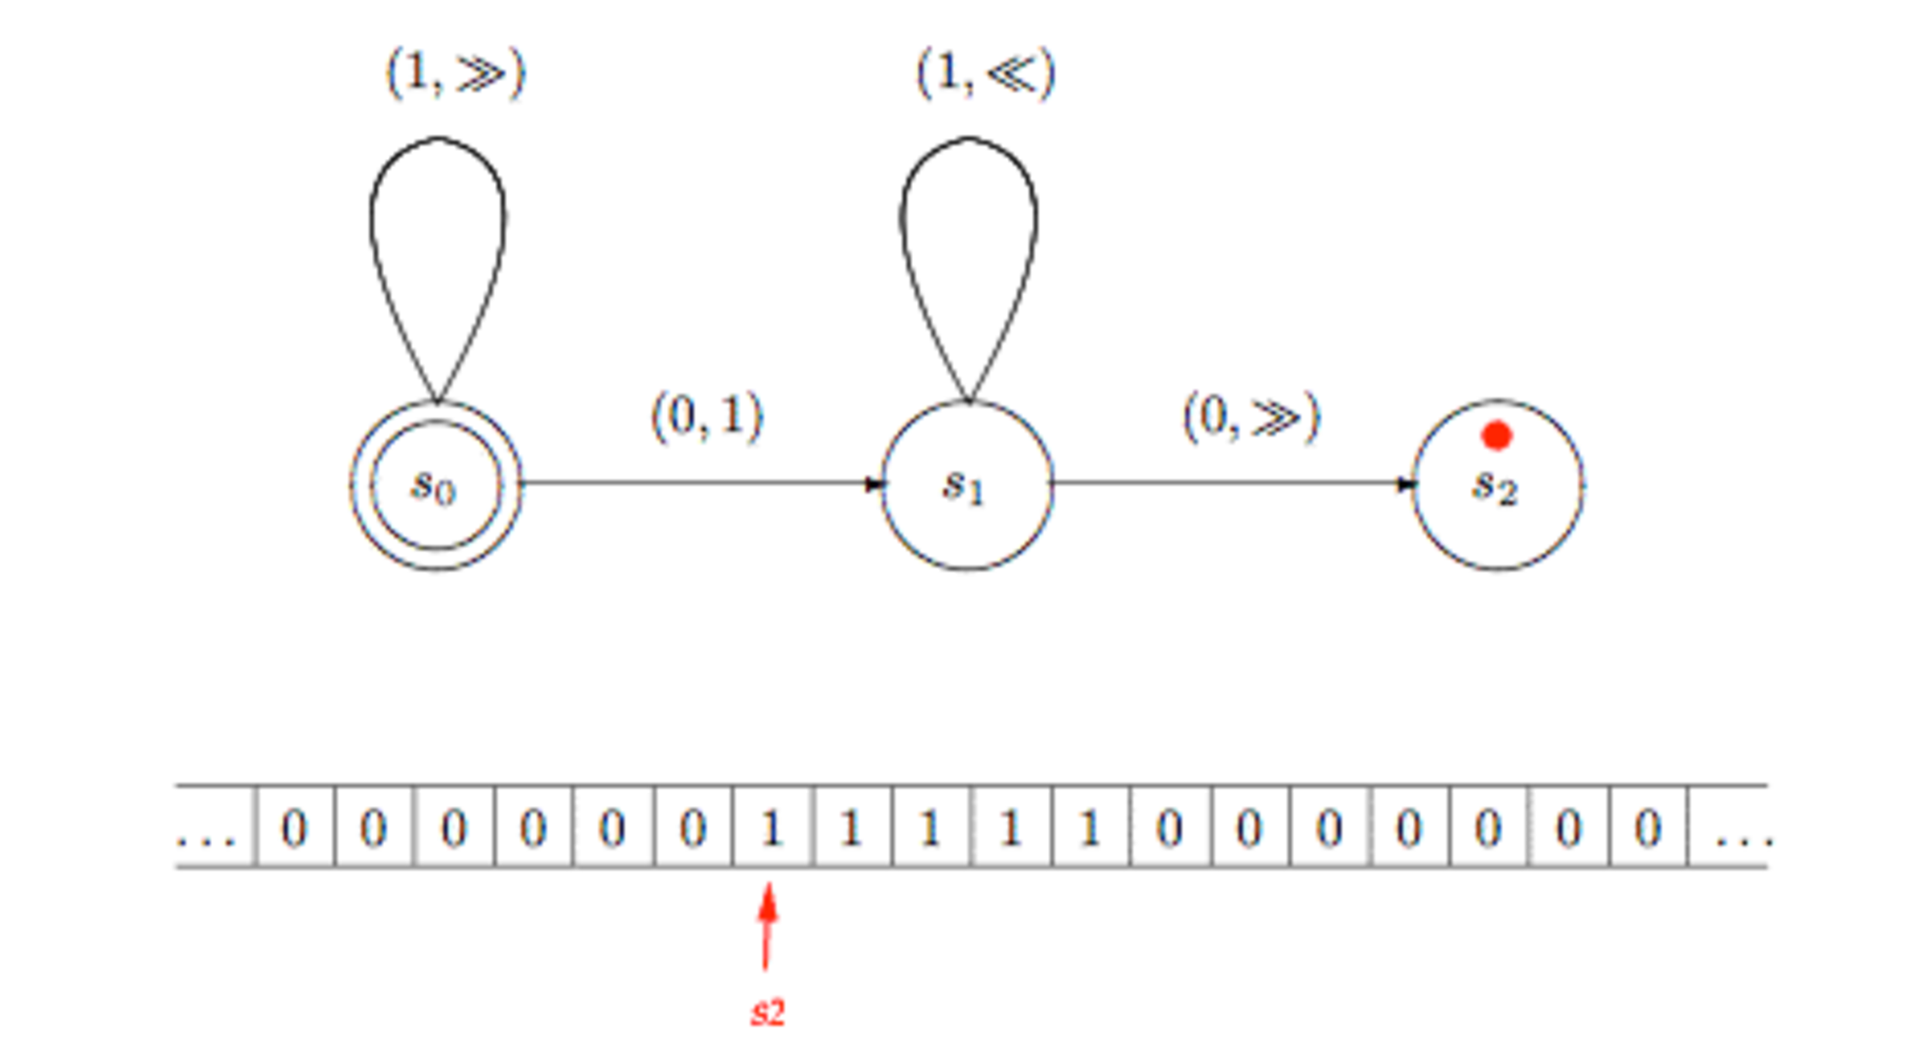
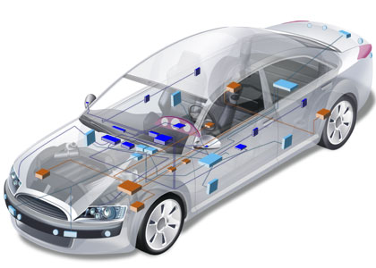

General purpose (programming) languages
Assembly COBOL Java LISP C++ PHP Scala C# Ruby Scheme Python…
17
Notes:
Turing

Slide 18
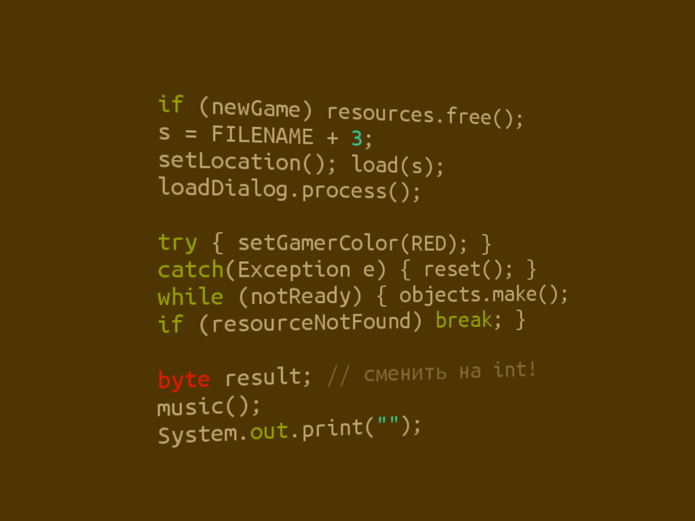



Limits of general purpose languages
Abstractions and notations are not natural/suitable for the stakeholders

Slide 19

Limits of general purpose languages
Not targeted to a particular kind of problem, but to any kind of software problems
Flexibility comes at a price
Conceptual gap
Accidental complexity
Maintenance, evolution
Not necessary for many problems

Slide 20
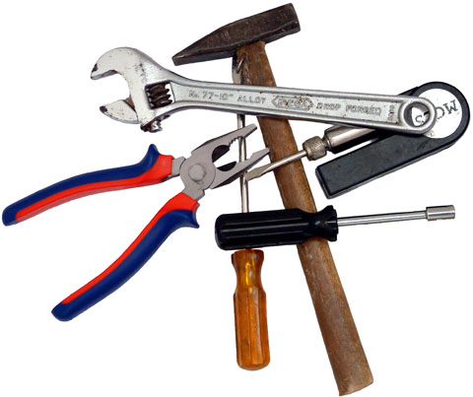
Domain-Specific Languages
Targeted to a particular kind of problem, with dedicated notations (textual or graphical), support (editor, checkers, etc.)
Promises: more efficient languages for resolving a set of specific problems in a domain
Long history: as long as computing
You use DSLs on daily basis
Examples to come

Slide 21
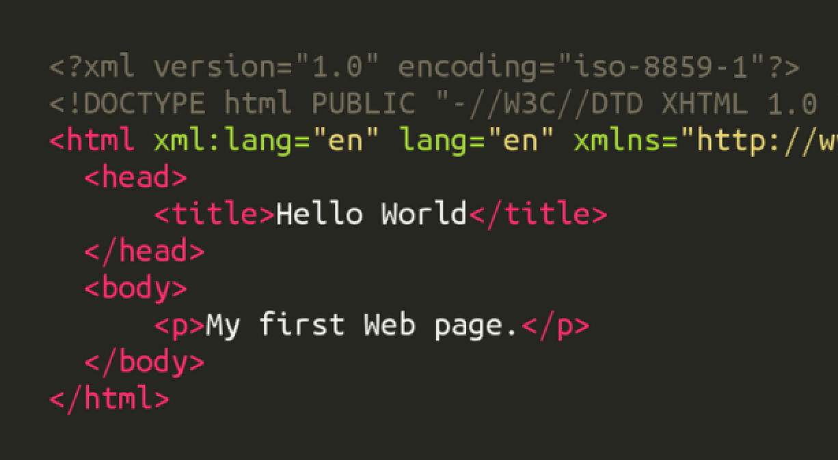
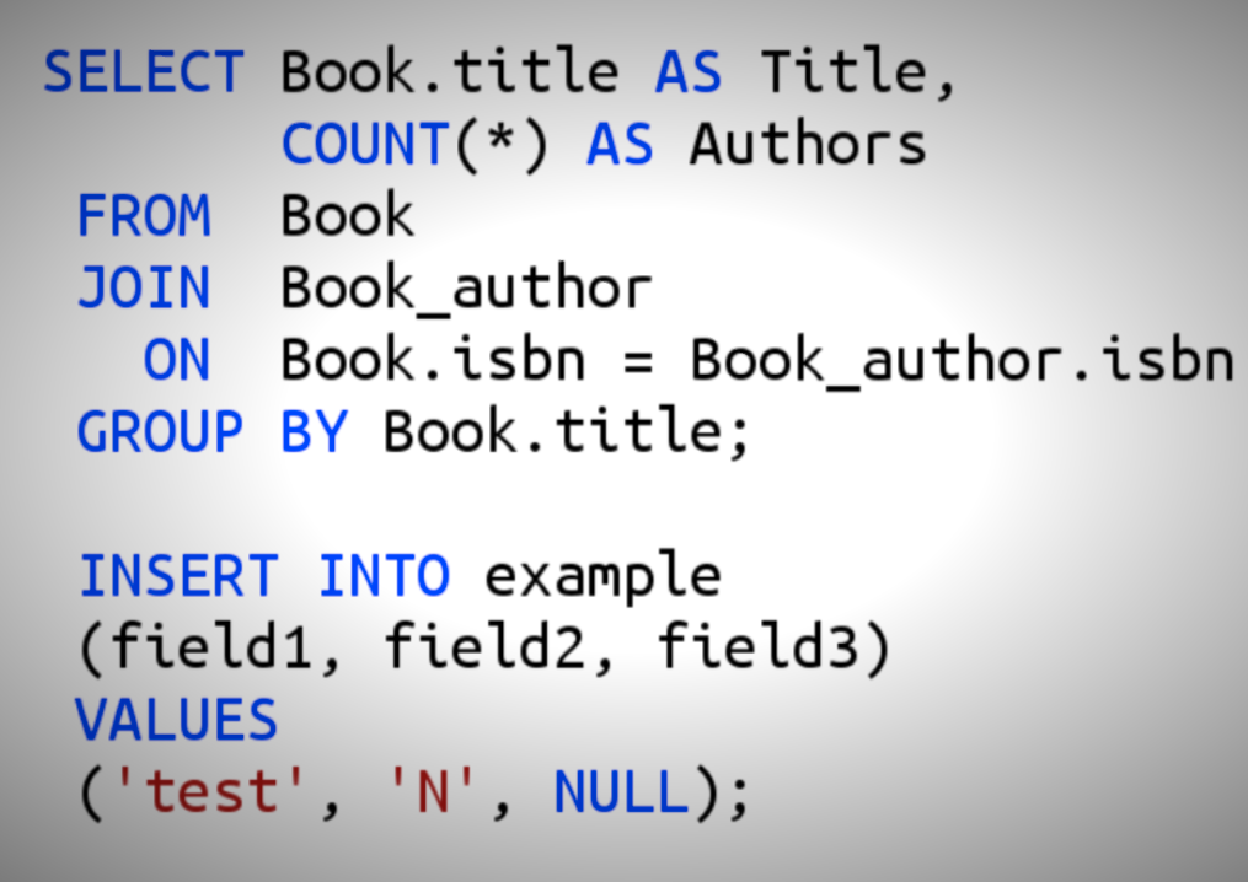
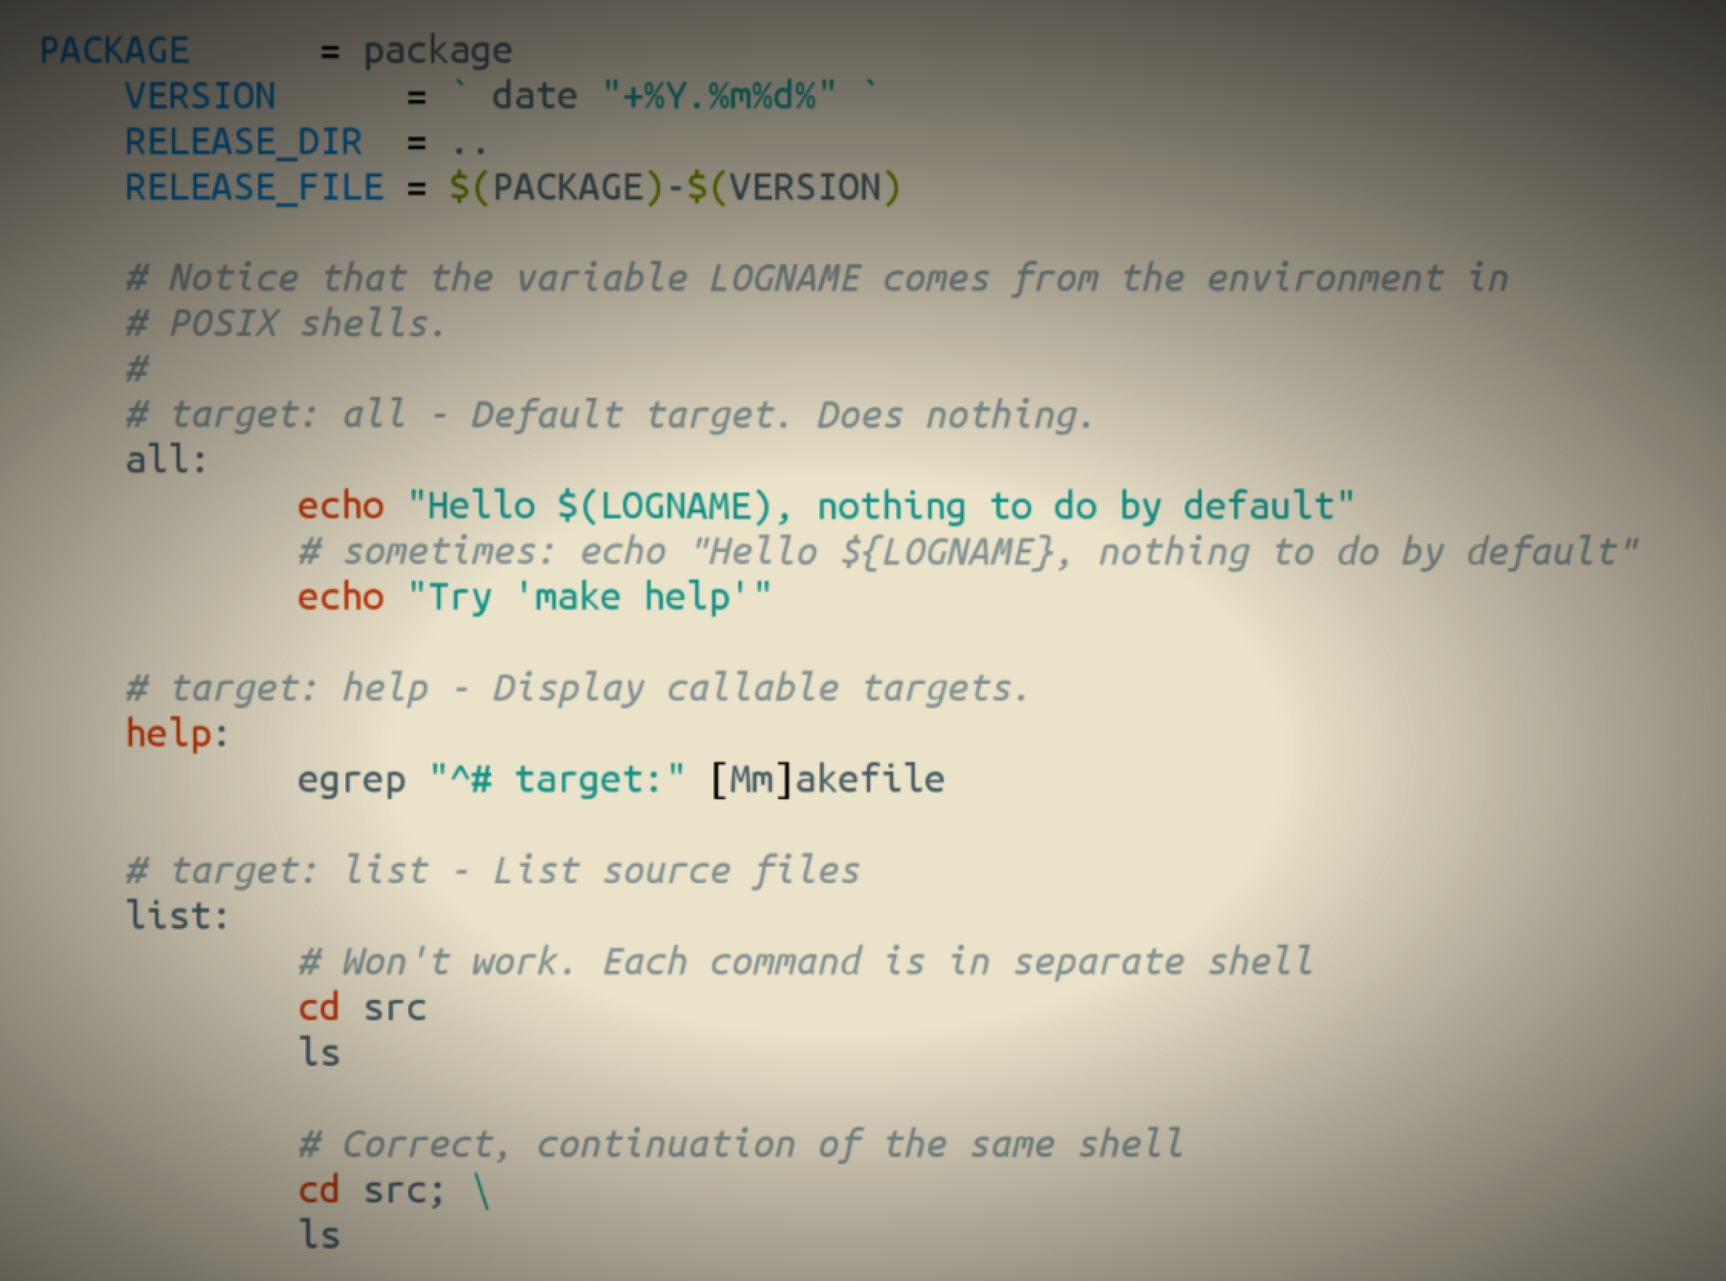
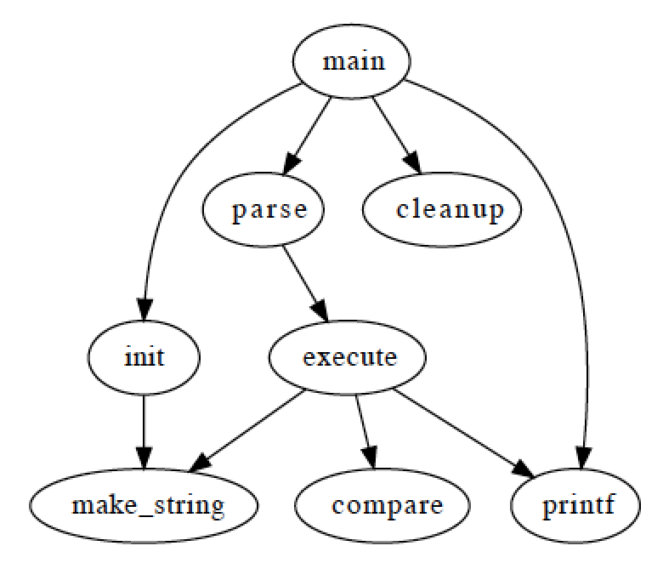
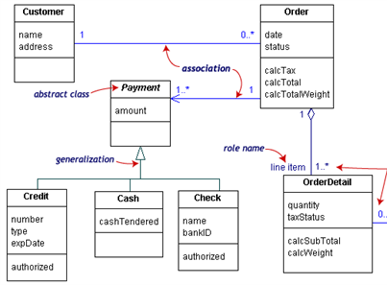
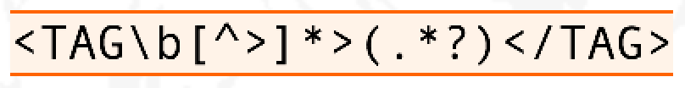
Examples
HTML
SQL
Makefile
Graphviz
Regular Expressions
UML

Slide 22
Software Language Engineering (SLE)
Application of systematic, disciplined, and measurable approaches to the development, deployment, use, and maintenance of software (domain-specific) languages
Supported by various kind of language workbenches
Eclipse EMF, xText, Sirius, Melange, GEMOC, Papyrus
Jetbrain’s MPS, MontiCore, Rascal, MS DSL Tools
etc.
Various shapes and ways to implement software languages
External, internal or embedded DSLs, Profile, etc.
Grammar, metamodel, ontology, etc.
More and more literature, a dedicated Intl. conference (ACM SLE, cf. www.sleconf.org)…

Slide 23
What are languages made of?
“The words, their pronunciation, and the methods of combining them used and understood by a community”
Concrete syntax: their words
Abstract syntax: their combination methods
Semantics: how they understood
Notes:
AS ~ grammar

Slide 24
Model-driven engineering (MDE)
Language Engineering
Modeling
Engineering Modeling Languages: Turning Domain Knowledge into Tools, by Benoit Combemale, Robert B. France, Jean-Marc Jézéquel, Bernhard Rumpe, Jim R.H. Steel, and Didier Vojtisek. Chapman and Hall/CRC, pp.398, 2016. Companion website: http://mdebook.irisa.fr

Slide 25
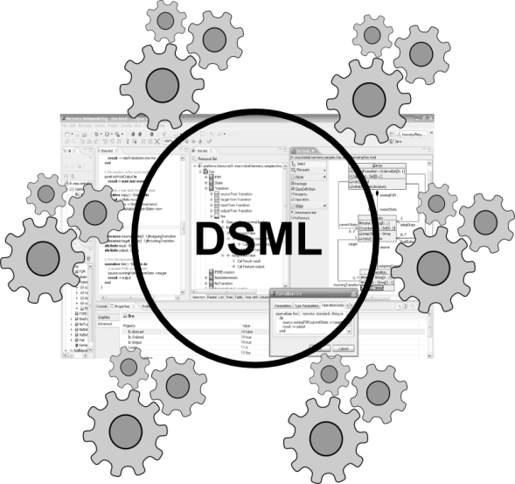
Concerns in model-driven engineering
Editors
(textual, graphical, …)
Checkers
(static & dynamics)
Compilers
Test generators
Translators
Simulators
Code generators
Analyzers
Refactoring
etc.
Engineering Modeling Languages: Turning Domain Knowledge into Tools, by Benoit Combemale, Robert B. France, Jean-Marc Jézéquel, Bernhard Rumpe, Jim R.H. Steel, and Didier Vojtisek. Chapman and Hall/CRC, pp.398, 2016. Companion website: http://mdebook.irisa.fr

Slide 26
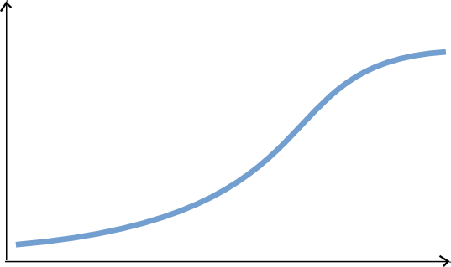
State of the art
Complete environment
Large scale deployment and distribution
Rich modeling tooling
(graphical, textual, forms)
Live Collaboration (cf. Google docs)
Customizations
Large models
Parametric code generators
Documentation generators
Analysis tools
Mission critical : tested and validated!
Easy automation
Basic editing features
Reflective and dynamic editors
Classic collaboration
EMF compare
Code generation!
Environment Completeness
Lot of work
Ease of Automation
Some hours
Features
Notes:
Learning curve very flat in the beginning

Slide 27
Montiarc ADL
DIGRESSION

Slide 28
MontiArc¹ in a nutshell
Extensible component & connector ADL
Based on Focus semantics for distributed systems²
semantics domain are stream-processing functions
Minimal design featuring
component types and instance, component inheritance
atomic and hierarchically composed components
component interfaces of typed, directed ports
1st version: textual with MontiCore³ language workbench
Haber, A. (2016). MontiArc - Architectural Modeling and Simulation of Interactive Distributed Systems
Ringert, J. O., & Rumpe, B. (2011). A Little Synopsis on Streams, Stream Processing Functions, and State-Based Stream Processing.
Krahn, H., Rumpe, B., Völkel, S. (2008). MontiCore: Modular Development of Textual Domain Specific Languages

Slide 29
MontiArc extensions
Δ-MontiArc¹ is a DSL for expressing deltas on MontiArc component definitions, for bottom-up product lining.
MontiArcHV² allows specifying component variability fully integrated within the component hierarchy located at variation points in component definitions.
clArc³ is a variant for modeling self-replicating cloud services.
MontiArcAutomaton⁴ extends MontiArc with behavior language embedding and robotics-related modeling elements.
Haber, A., Rendel, H., Rumpe, B., Schaefer, I. (2012). Evolving Delta-oriented Software Product Line Architectures.
Haber, A., Rendel, H., Rumpe, B., Schaefer, I., van der Linden, F. (2012). Hierarchical Variability Modeling for Software Architectures.
Navarro Perez, A., Rumpe, B. (2013). Modeling Cloud Architectures as Interactive Systems.
Wortmann, A. (2016). An Extensible Component & Connector Architecture Description Infrastructure for Multi-Platform Modeling.

Slide 30
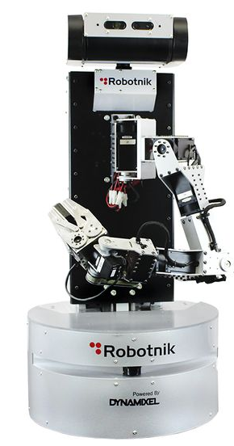
MontiArc example
CD
Garbages
Pose
ArmPose
composed
component
generic data type parameter
CD data types
subcomponent injection
CleaningRobot
MA
Garbage Detector
Garbages
ActionController<T>
ctrl
Pose
Navigation nav
FSM
Arm(Planner p)
Planner p
ArmPose
ArmCtrl
Container Checker
Int
Gripper
gr
s
T
cs
Bool
unidirectional connector between ports s and cs of type Boolean
atomic component with embedded port automaton model
subcomponent gr of type Gripper

Slide 31
XMontiArc¹
MontiArc variant for operational execution
Built on top of GEMOC Studio
Ecore metamodel
OCL static semantics
Kermeta dynamic semantics
Sirius graphical representation
Uses fixed data types (boolean, number, string)
Does not support parametrization, generics, or injection (yet)
Includes FSM language for component behavior modeling
https://github.com/awortmann/xmontiarc

Slide 32
XMontiArc Example
composed
component
CleaningRobot
XMA
Garbage Detector
Number
ActionController ctrl
Number
Navigation nav
Number
Number
FSM
Arm
Planner p
Number
ArmCtrl
Number
Container Checker
Number
Gripper
gr
Boolean
Boolean
s
cs
unidirectional connector between ports s and cs of type Boolean
atomic component with embedded port automaton model
subcomponent gr of type Gripper

Slide 33
XMontiArc Example
composed
component
CleaningRobot
XMA
Garbage Detector
Number
ActionController ctrl
Number
Navigation nav
Number
Number
FSM
Arm
Planner p
Number
ArmCtrl
Number
Container Checker
Number
Gripper
gr
Boolean
Boolean
s
cs
unidirectional connector between ports s and cs of type Boolean
atomic component with embedded port automaton model
subcomponent gr of type Gripper
Graphical representation of intermediate connectors
Embedding of FSM for component behavior

Slide 34
MODEL EXECUTION
STEP 2.1

Slide 35
Eclipse as a platform
Integrated development platform with base workspace and an extensible plug-in system
Contribute to existing IDE
Open structure with third party contributions
Update site, market place, …
Or create your own application
Rich Client Platform (RCP) for general purpose applications
Don’t be afraid of the number of workspace projects
Most of them are due to splitting the java packages for easier deployment and dependency management.

Slide 36
Modeling workbench vs. language workbench
We use eclipse as a language workbench in which we define the constituents of and services for languages in form of eclipse plugins.
From this we start another eclipse instance – the modeling workbench.
Into this, we deploy the tools and services to create models conforming to the language(s) defined in the language workbench.

Slide 37
2.1 Running the FSM example

Slide 38
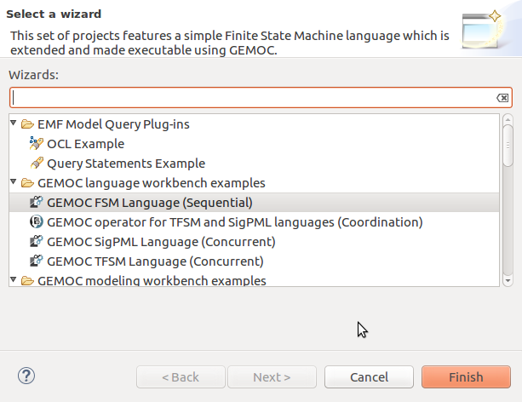
Load the FSM language
(see https://github.com/gemoc/ICSA2017Tutorial)

Slide 39
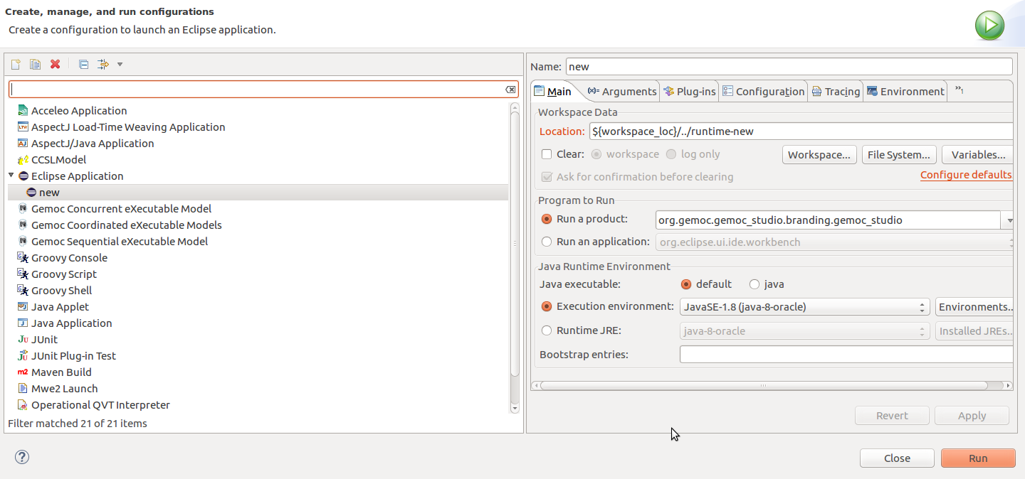
Start the modeling workbench
(see https://github.com/gemoc/ICSA2017Tutorial)

Slide 40
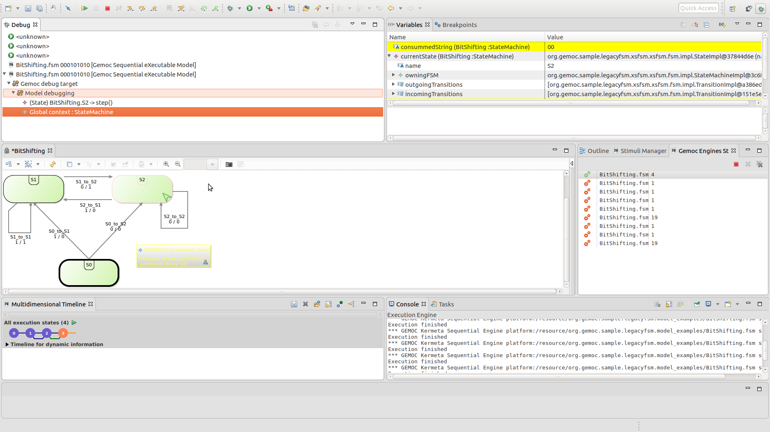
Examine and run your models
stack trace
variable values
graphical model representation
execution trace
(see https://github.com/gemoc/ICSA2017Tutorial)

Slide 41
ABSTRACT SYNTAX EXTENSION
STEP 2.2

Slide 42
Abstract syntax defines your domain
We use Ecore to define the concepts and relations of the domain of FSMs
Alternatives are MOF, grammars, …
Editors
(textual, graphical, …)
Checkers
(static & dynamics)
Documentation generators
Compilers
Test generators
Translators
Simulators
Code generators
Analyzers
Refactoring
Etc.

Slide 43
Ecore/EMF
EMF serves as the foundation: It provides the Ecore meta-metamodel (basically a Class diagram ), and frameworks and tools around it :
EMF provides almost for free (among other features)
Serialization (XMI)
Tree editor
either reflective, or generated with possibility to customize
Edition support (outline, notification API for other editors, …)
Java manipulation API
EMF compatible projects use this as a base to propose extended services

Slide 44
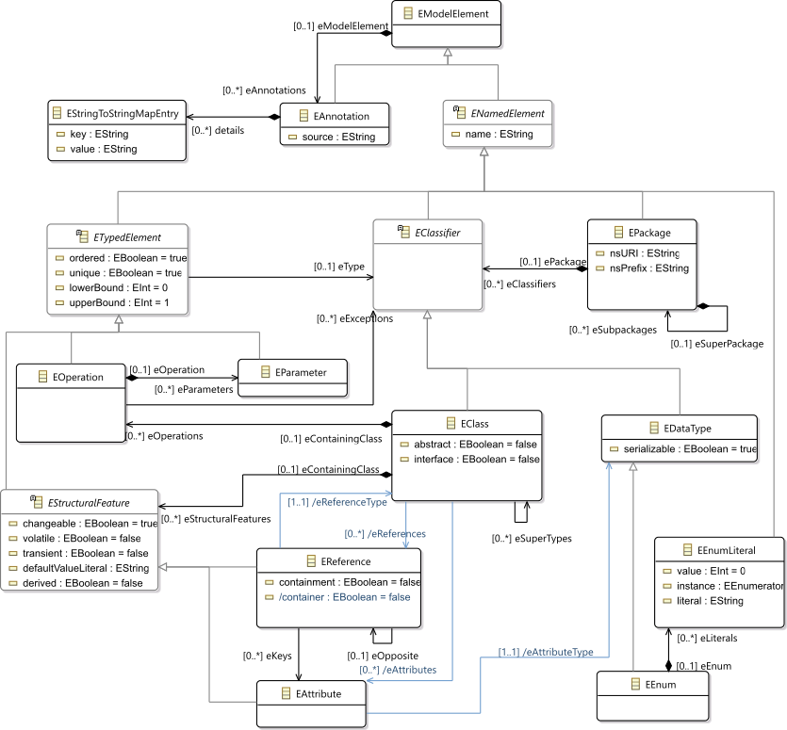
Ecore most used concepts
(removed most helper derived features, operations and generic support)

Slide 45
OCL invariants
Class diagram structure implies design choices
Invariants (e.g., in OCL) can complement it in order to enforce the consistency of models
Editors
(textual, graphical, …)
Checkers
(static & dynamics)
Documentation generators
Compilers
Test generators
Translators
Simulators
Code generators
Analyzers
Refactoring
Etc.

Slide 46
2.2 Adding new concepts to your language

Slide 47
Extend FSM abstract syntax
Add concepts for variables, guards, and actions to your FSM language
Use the graphical metamodel editor
Add an OCL invariant to your language

Slide 48
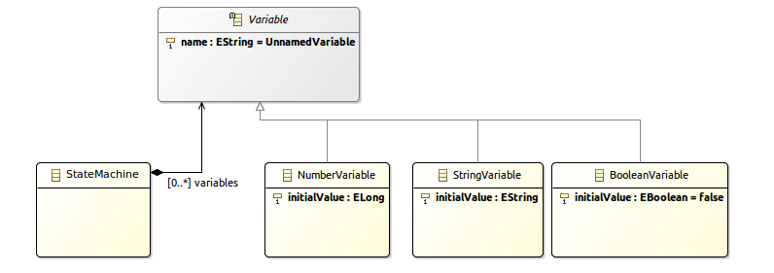
Add concept Variable
(see https://github.com/gemoc/ICSA2017Tutorial)

Slide 49
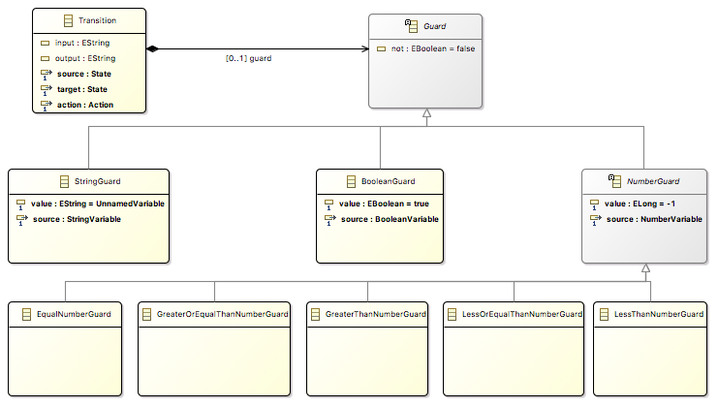
Add concept Guard
(see https://github.com/gemoc/ICSA2017Tutorial)

Slide 50
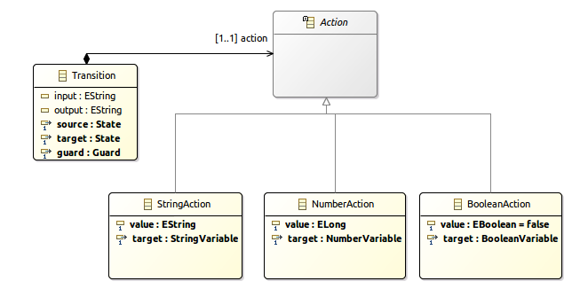
Add concept Action
(see https://github.com/gemoc/ICSA2017Tutorial)

Slide 51
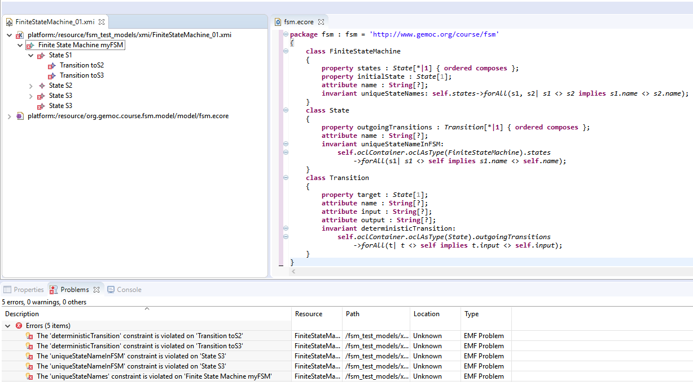
Add OCL invariant
Use the OCLInEcore editor
Add invariant: states cannot have two outgoing transitions without a guard
Syntax example: check name uniqueness
invariant uniqueStateNames:
self.states->forAll(s1, s2| s1 <> s2 implies s1.name <> s2.name);
(see https://github.com/gemoc/ICSA2017Tutorial)

Slide 52
DYNAMIC SEMANTICS EXTENSION
STEP 2.3

Slide 53
Adding behavior to models
Two main ways to add behavior
Operational: using interpreters
Translational: code generation
Editors
(textual, graphical, …)
Checkers
(static & dynamics)
Documentation generators
Compilers
Test generators
Translators
Interpreters
Code generators
Analyzers
Refactoring
etc.

Slide 54
Adding operational behavior to models
Usually abstract syntax traversal navigating the model
Adding operations to Ecore enables adding behavior to metamodel
but breaks separation of concerns and language reuse
Traditional approaches: visitor design pattern
However, it doesn't scale to
multiple metamodels
language composition
modular adding of new functionality
Notes:
Expression problem of OO

Slide 55
Meet Kermeta and Melange
Kermeta
Advanced visitor pattern to add aspect oriented behavior
see classes as if they where "reopened" and extended
Supports adding operations, attributes, associations, inheritance
@Main denotes entry points
@Step executable model parts
Melange
Language definition language
Compose static metamodel (Ecore) with dynamic aspects (Kermeta) to generate a language implementation

Slide 56
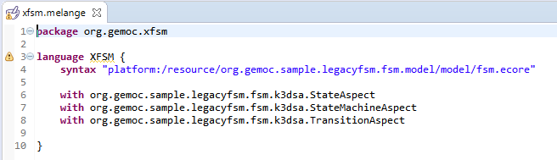
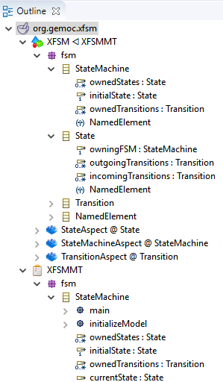
Combining language parts with Melange
xx
Adds operation and attributes
may add new concepts too by using multiple Ecore files
Melange generates the new resulting implementation

Slide 57
2.3 Completing the dynamic semantics of FSM

Slide 58
Extend FSM dynamic semantics
The FSM aspects are defined in the file tfsmAspects.xtend of project org.gemoc.sample.legacyfsm.fsm.k3dsa
Investigate these (watch for @Main and @Step)
Two methods are not implemented (marked ”TODO”): please implement these
(see https://github.com/gemoc/ICSA2017Tutorial)

Slide 59
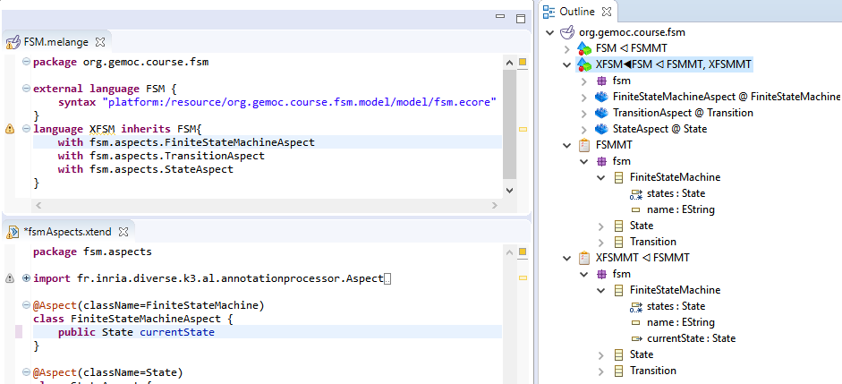
Edit Kermeta aspects
(see https://github.com/gemoc/ICSA2017Tutorial)

Slide 60

Generate executable language
(see https://github.com/gemoc/ICSA2017Tutorial)

Slide 61

Inspect woven-in operations
new operations
Check metamodel of generated project org.gemoc.sample.legacyfsm.xsfsm
(see https://github.com/gemoc/ICSA2017Tutorial)

Slide 62


Create and run extended model
(see https://github.com/gemoc/ICSA2017Tutorial)

Slide 63
Concrete syntax extension
STEP 2.4

Slide 64
Graphical concrete syntax with Sirius
Another plugin for the eclipse infrastructure
Enables creating graphical editors for ECore metamodels
Editors
(textual, graphical, …)
Checkers
(static & dynamics)
Documentation generators
Compilers
Test generators
Translators
Simulators
Code generators
Analyzers
Refactoring
etc.

Slide 65




Views for language engineers and modelers
Language engineers
Modelers
Specification environment
Runtime environment

Slide 66

Examples of viewpoints

Slide 67
2.4 Concrete graphical syntax with Sirius

Slide 68
Extend FSM concrete syntax
Define the representation of guards and actions instances for the static perspective.
Define the rendering of variables for the run-time representation.
(see https://github.com/gemoc/ICSA2017Tutorial)

Slide 69

Final representation
stack trace
variable values
textual representation of transition guards and actions
dynamic representation of variable values
tracing
(see https://github.com/gemoc/ICSA2017Tutorial)

Slide 70

Mind the different perspectives
(see https://github.com/gemoc/ICSA2017Tutorial)

Slide 71
WRAP-UP and Discussion
PART 3

Slide 72

Reifying concurrency in executable DSLs
Concurrency remains implicit and ad-hoc in language design and implementation:
Design: implicitly inherited from the meta-language used
Implementation: mostly embedded in the underlying execution environment
The lack of an explicit concurrency specification in language design prevents:
leveraging the concurrency concern of a particular domain or platform
a complete understanding of the behavioral semantics
effective concurrency-aware analysis techniques
effective techniques for producing semantic variants
analysis of the deployment on parallel architectures

Slide 73


Coping with semantic variation points
Florent Latombe, Xavier Crégut, Julien Deantoni, Marc Pantel, Benoit Combemale, "Coping with Semantic Variation Points in Domain-Specific Modeling Languages", In EXE@MoDELS 2015.

Slide 74

Summary of the sequential approach

Slide 75

Concurrency management

Slide 76


Activity diagram debugger
https://github.com/gemoc/activitydiagram

Slide 77

Model coordination
Once the event notion has been reified, it is then possible to reason about it.
i.e., un several models at the same time and coordinate them
In GEMOC we have, the Behavioral Coordination Operator Language

Slide 78









conforms
BCOoL
Specification
defines
generates
Know-how
System
Designer
System
Designer
when releaseCoffee
/ doLock
Model of
Coordination
when coin
/ !selectCoffee;
generates
generates
generates
generates
generates
generates
Language 2
Language 2
Language 2
Language 2
Language 2
Language 2
Conforms to
Conforms to
Conforms to
Conforms to
Conforms to
Conforms to
System
Designer
System
Designer
System
Designer
System
Designer
System
Designer
System
Designer
defines
defines
defines
defines
defines
defines
Model 1
Model 1
Model 1
Model 1
Model 1
Model 1
Coordination
/
Communication
Coordination
/
Communication
Coordination
/
Communication
Coordination
/
Communication
Coordination
/
Communication
Model 2
Coordination
/
Communication
Model 2
Model 2
Model 2
Model 2
Model 2
Model A
Model A
Model A
Model A
Model A
Model 3
Model A
Model 3
Model 3
Model 3
Model 3
Model 3
Model B
Model B
Model B
Model B
Model B
Model B
Model B
Model B
Model B
Model B
Model B
Model B

Slide 79
Take-away messages
DSLs are important (as intuited for a long time – it will become more and more apparent)
DSL technology is here and ready to use
Over 30 language workbenches in the wild (cf. http://2016.splashcon.org/track/lwc2016)
Software language engineering is maturing to support MDE

Slide 80
Wrap-up and discussion
Today you have
executed models of the FSM language
extended its Ecore metamodel with new variables, guards, and transitions
restricted it using OCL well-formedness rules
augmented its dynamic semantics to consider the new modeling elements using Kermeta
extended its concrete graphical syntax and editor using Sirius
combined two modeling languages to produce executable architecture models using Melange
We hope you enjoyed it and are consider building your own DSLs where appropriate
Before you leave: please answer six questions: https://goo.gl/NKZLAF

Slide 81
Thank you
The End

